Slide 1
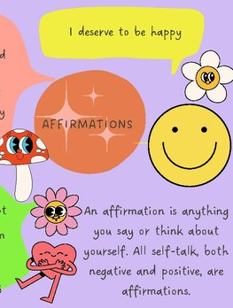
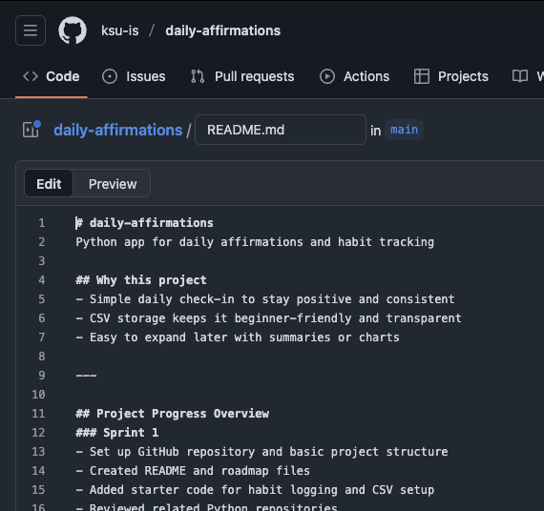
Daily Affirmations
A simple way to stay consistent & positive —
One daily habit at a time.
Team Member: Abigail Henderson​​
GitHub: https://github.com/ksu-is/daily-affirmations​
​
​
About the Project:​
A simple Python app designed to help users stay consistent with positive habits and motivation through daily affirmations.​
​
Current Progress:​
- Created GitHub repository and organized project files​
- Wrote base code for habit logging​
- Added CSV setup for tracking daily check-ins​
​
Next Steps:​
- Test and debug the Python script​
- Add random daily affirmation messages

